Slide 1

REAL ESTATE HOUSE PRICE PREDICTION
Presented by:
Niharika Gorain- C 1 Batch
Ramansh Sangal- C1 Batch

Slide 2
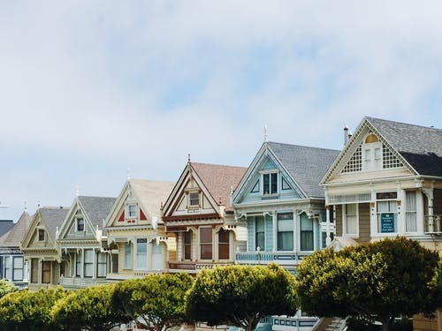
Project AIM
Predicting the price of the House in a particular area by using the Dataset i.e. the previous sale records.

Slide 3
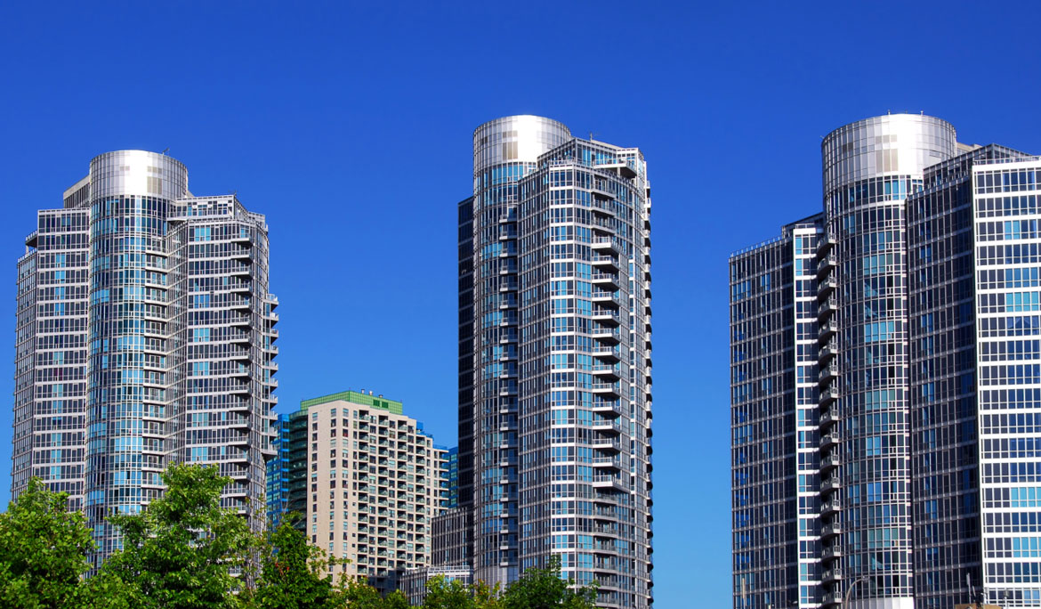
Our Objective
The objective of this project is to create a regression model that are able to accurately estimate the price of the house .
We will take house location, total square feet area, no. of bathrooms and BHK size from the user and we will provide them with the per square feet price.

Slide 4
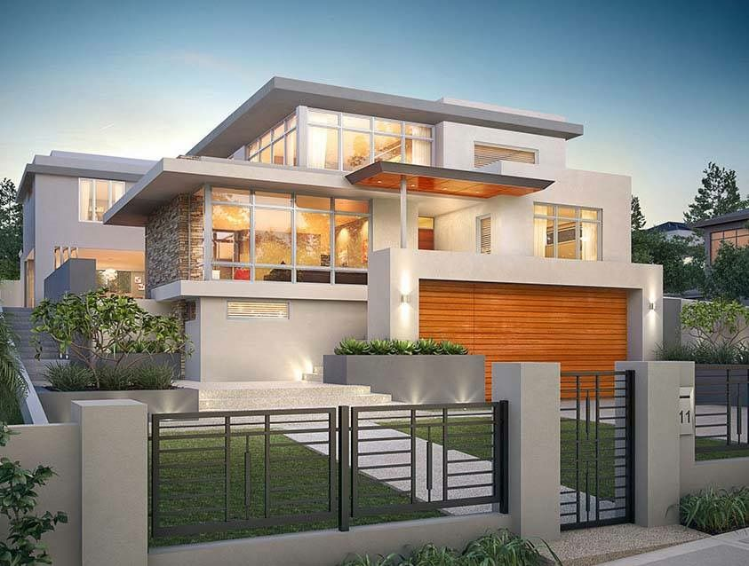
Scope
Housing prices are an important reflection of the economy, and housing price ranges are of great interest for both buyers and sellers. In this project, house prices will be predicted given explanatory variables that cover many aspects of residential houses.

Slide 5

Technology And Software
Details about the technology and the built in packages we are using.

Slide 6

Machine Learning (ML)
Technology
Machine learning is an application of artificial intelligence (AI) that provides systems the ability to automatically learn and improve from experience without being explicitly programmed.
The process of learning begins with observations or data, such as examples, direct experience, or instruction, in order to look for patterns in data and make better decisions in the future based on the examples that we provide. The primary aim is to allow the computers learn automatically without human intervention or assistance and adjust actions accordingly.

Slide 7


Software
Anaconda Navigator
Anaconda Navigator is a desktop graphical user interface (GUI) included in Anaconda® distribution that allows you to launch applications and easily manage conda packages, environments, and channels without using command-line commands.
.
Via Anaconda we use Jupyter Notebook
The Jupyter Notebook is an open-source web application that allows you to create and share documents that contain live code, equations, visualizations and narrative text.

Slide 8
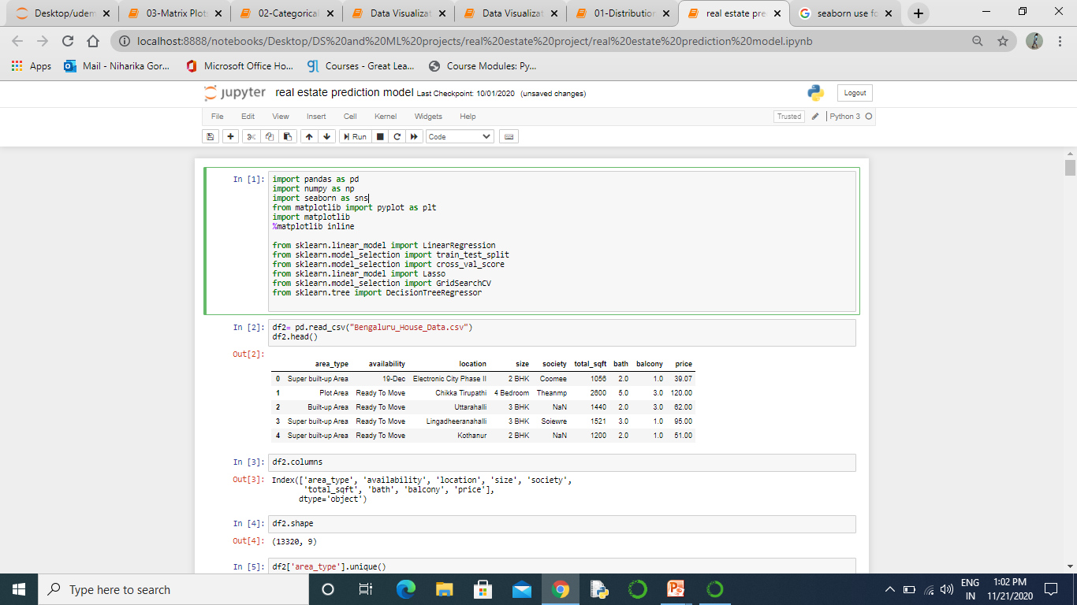
Pandas provides in-memory 2d table object called Dataframe.
Packages used
NumPy library which provides objects for multi-dimensional arrays.
Seaborn is a Python data visualization library based on matplotlib. It provides a high-level interface for drawing attractive and informative statistical graphics.
matplotlib.pyplot is a collection of functions that make matplotlib work like MATLAB. Each pyplot function makes some change to a figure: e.g., creates a figure, creates a plotting area in a figure etc.
Train_test_split used to split up the data into a training set and a test set
All other packages are used for performing LinearRegression, Lasso Regression, DecisionTreeRegressor and for calculating cross validation score.

Slide 9
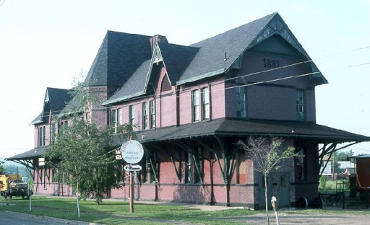
Dataset

Slide 10
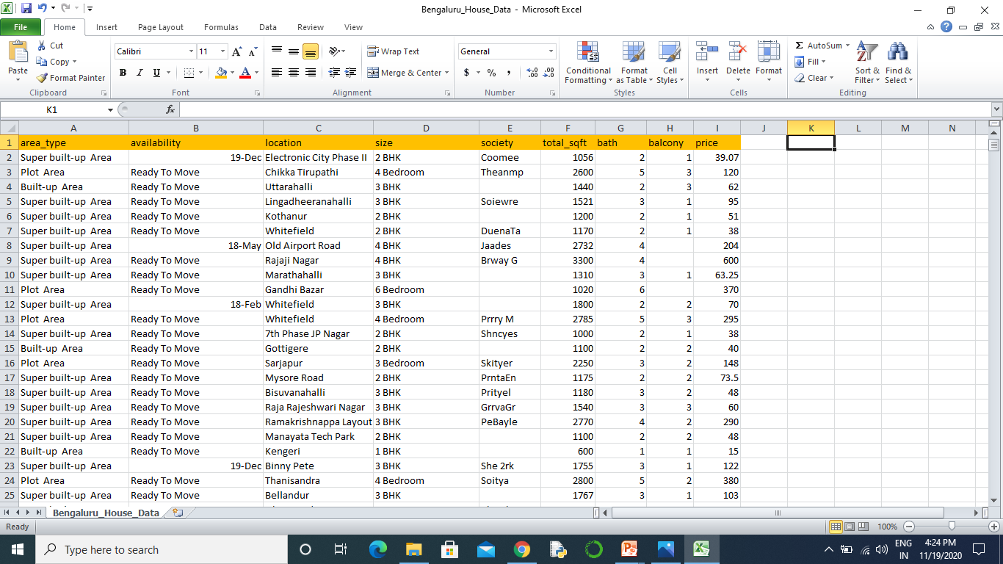

We get this dataset from kaggle, with a total of 13320 Rows and 9 Columns.

Slide 11
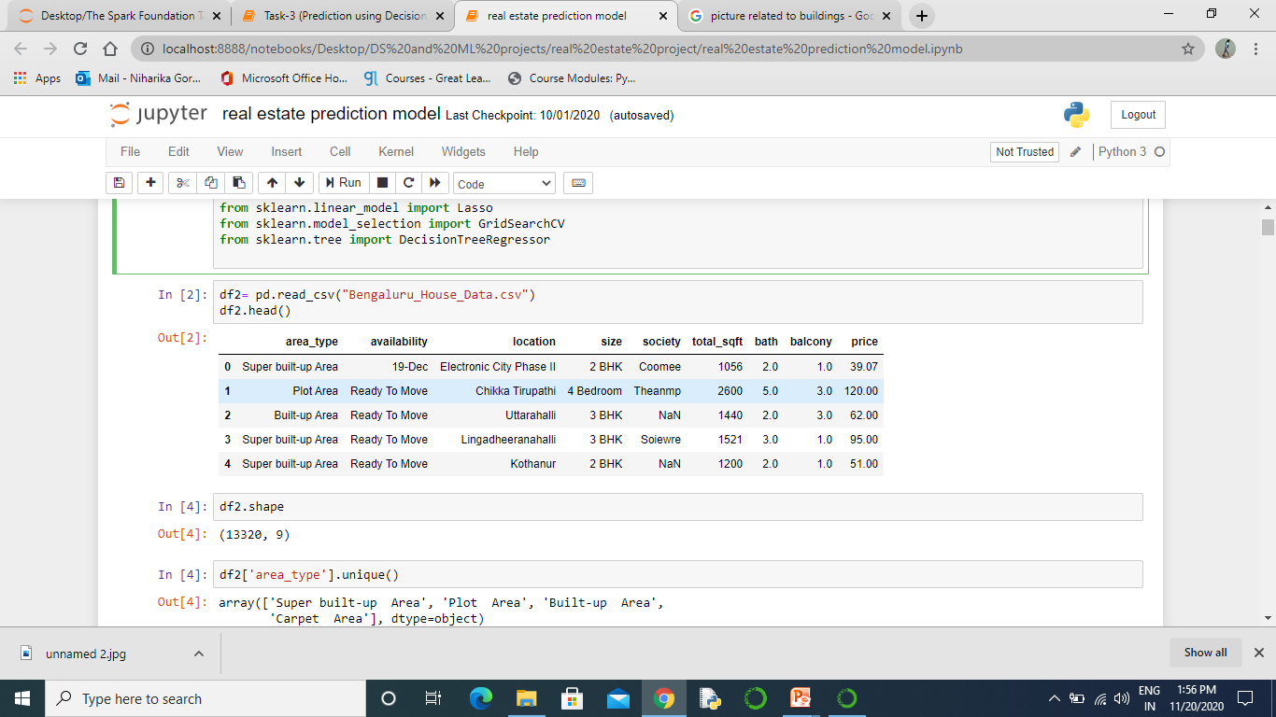
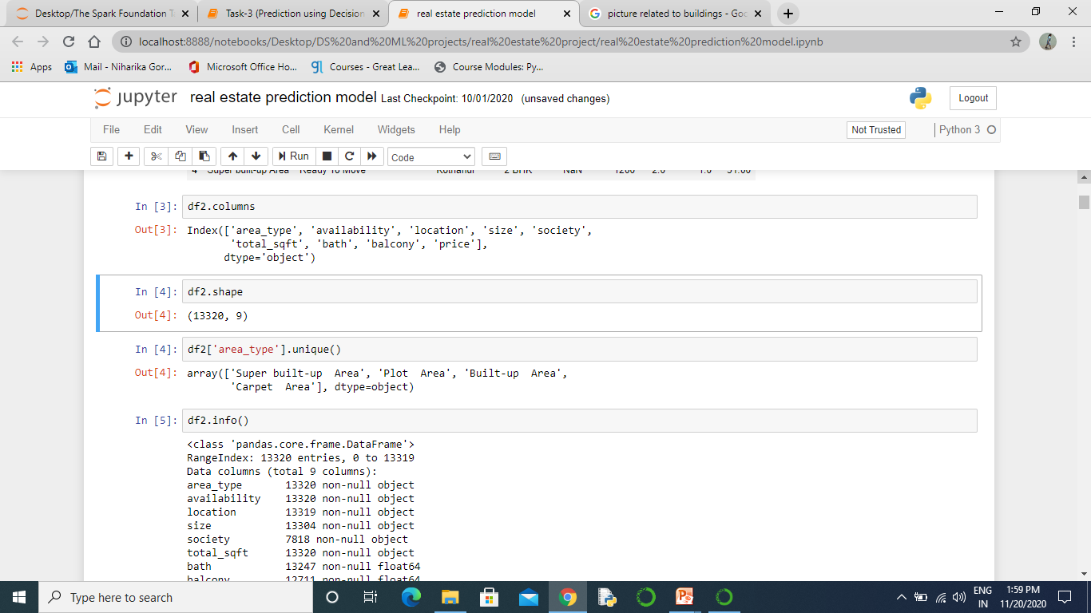
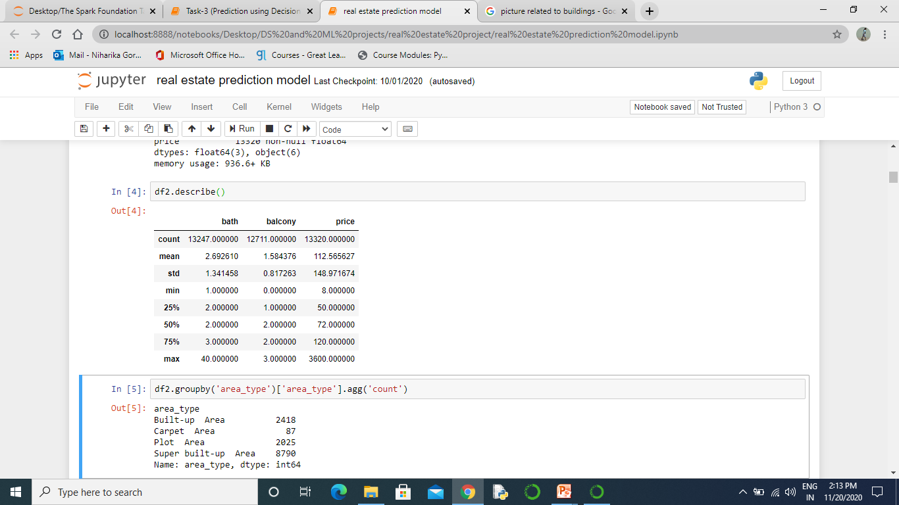

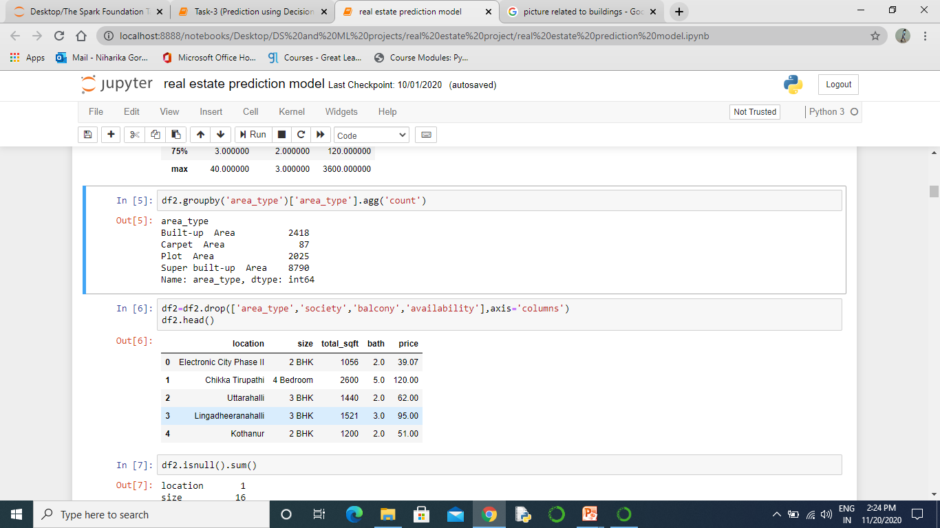
Loading Dataset
Size of Dataset
Table Description
Columns Names
Non-null values in each column
No. of houses present in 4 unique Area

Slide 12
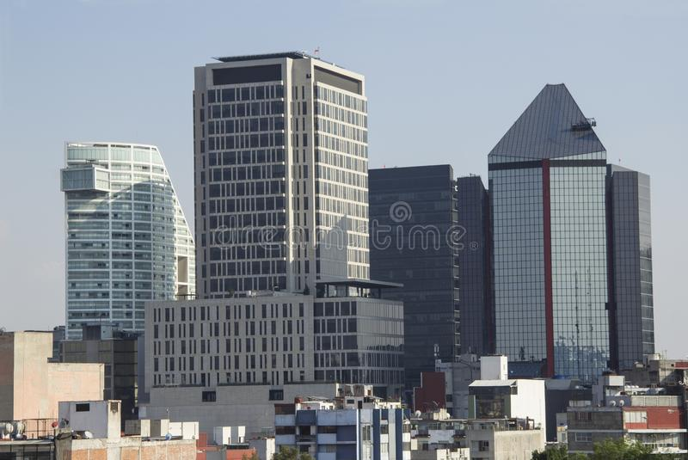
Data Cleaning
Manipulating data for calculations and visualization.

Slide 13
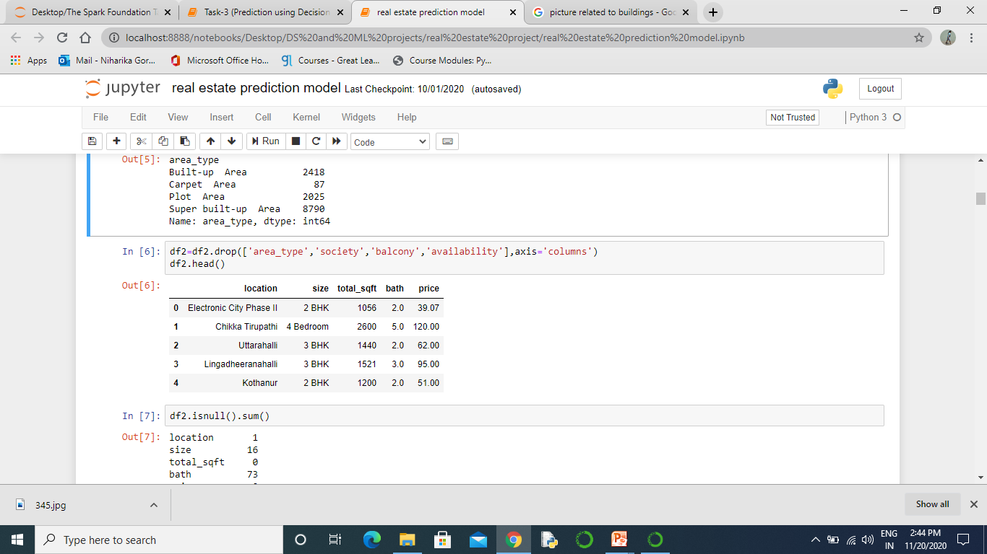
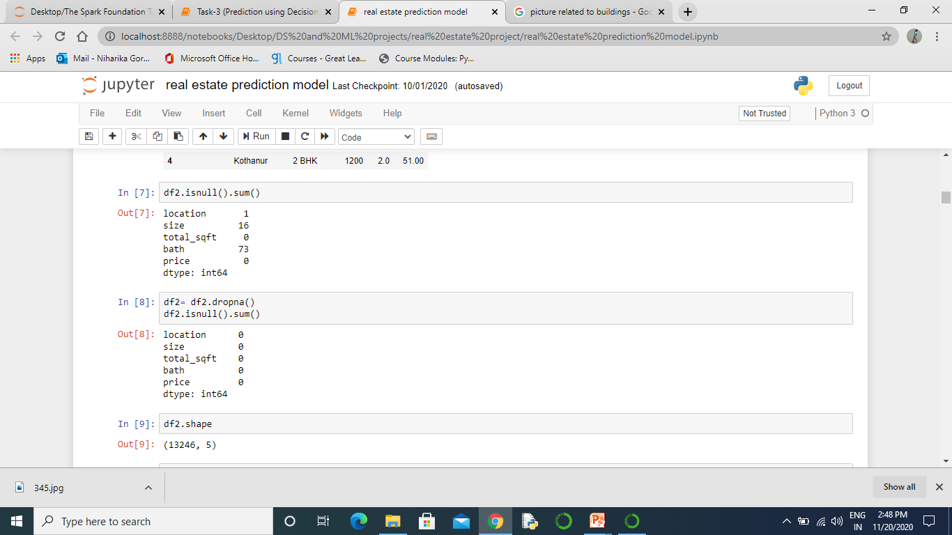
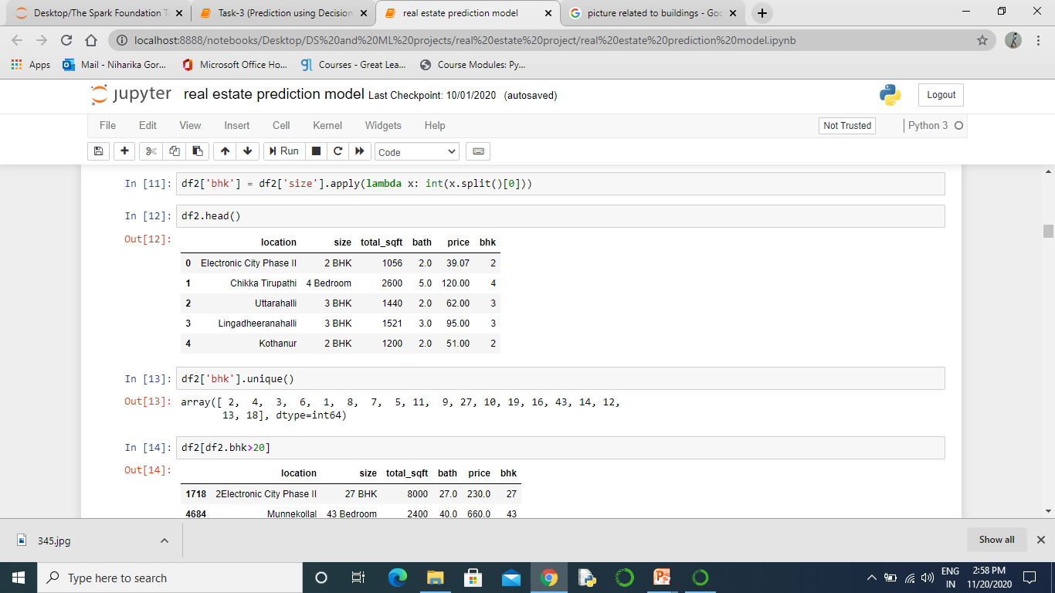
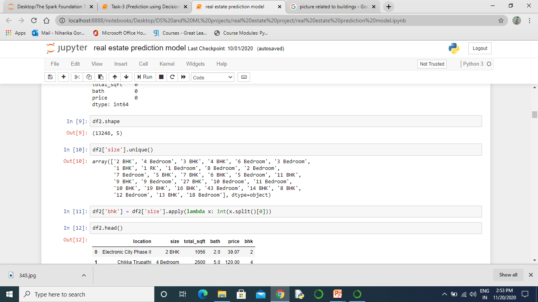
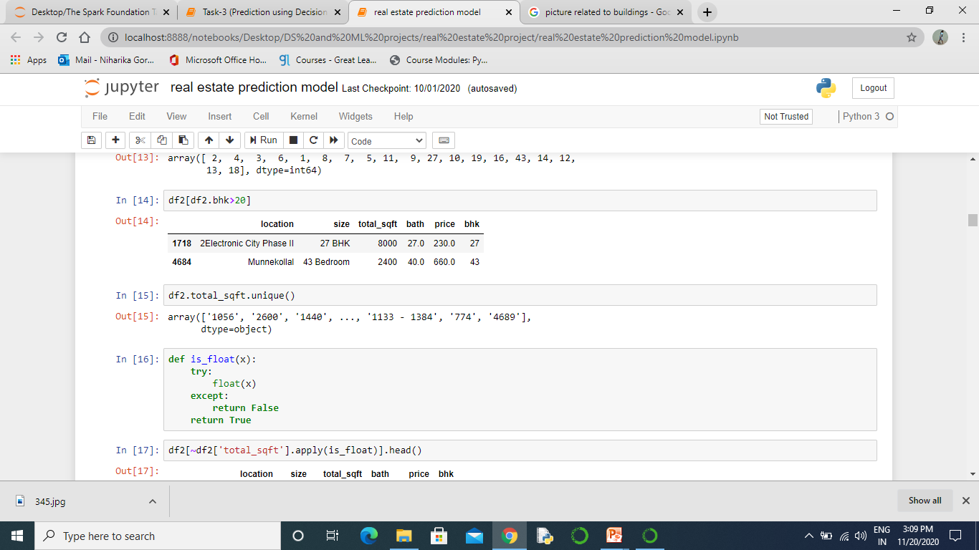
Dropping all useless columns
Removing all the null values
Making new column “Bhk’’ with integer data by Splitting “Size’’ column
Unique size of houses
Only 2 house have bkh>20

Slide 14

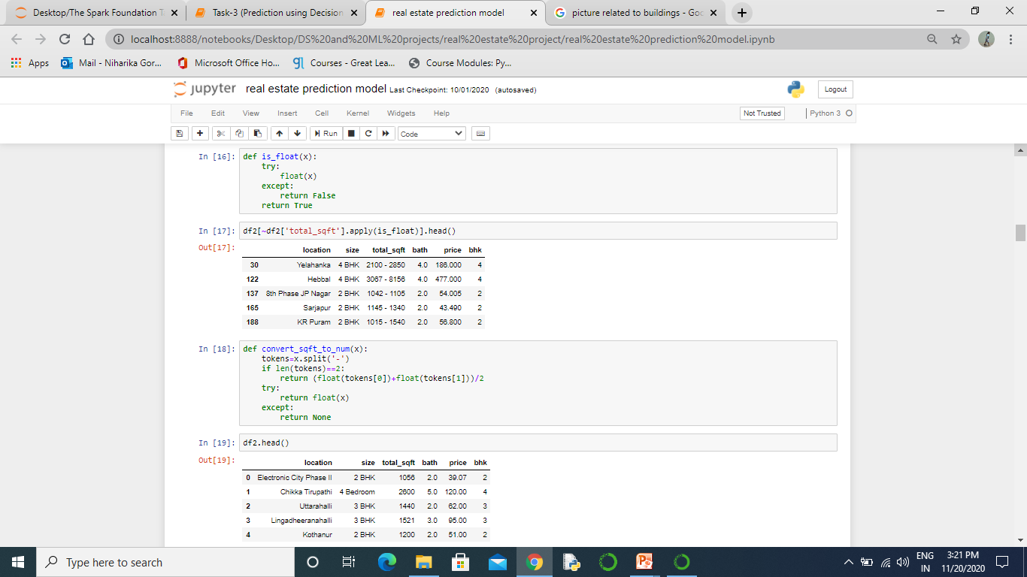
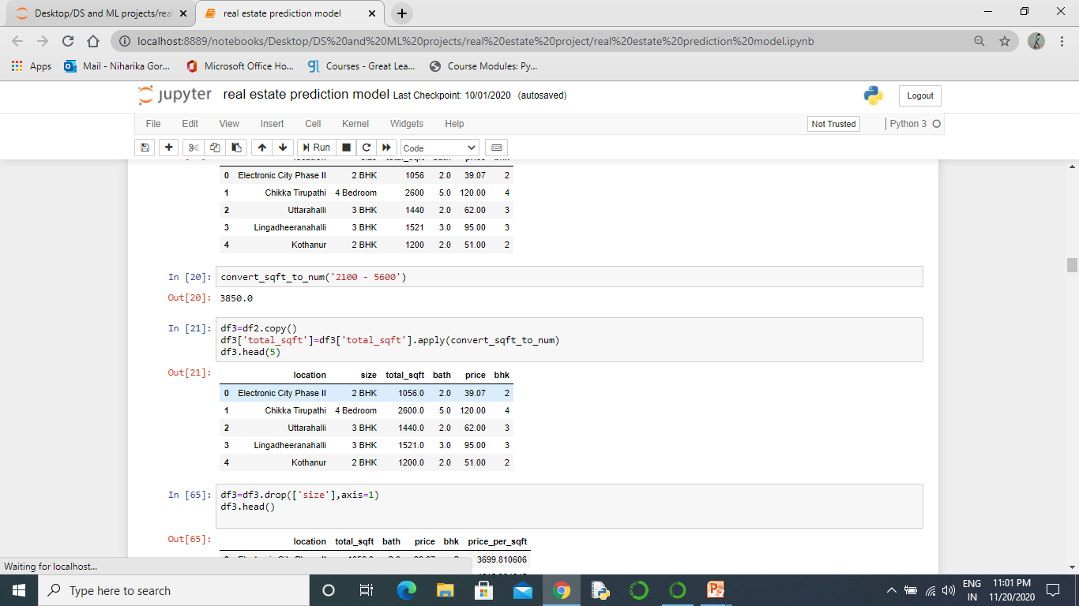
As we can see in “total_sqft’’ column there is discontinuity in pattern of the values because of values like 1133 – 1384 (in range)
is_float(x) function is used to find the values like 1133-1384(in range) from column “total_sqft’’
Data having “total_sqft’’ values in range in total 190 rows.
convert_sqft_to_num(x) function is used for calculating the average of the disturbed values only and rest values will be same.
This is how convert_sqft_to_num(x) works

Slide 15
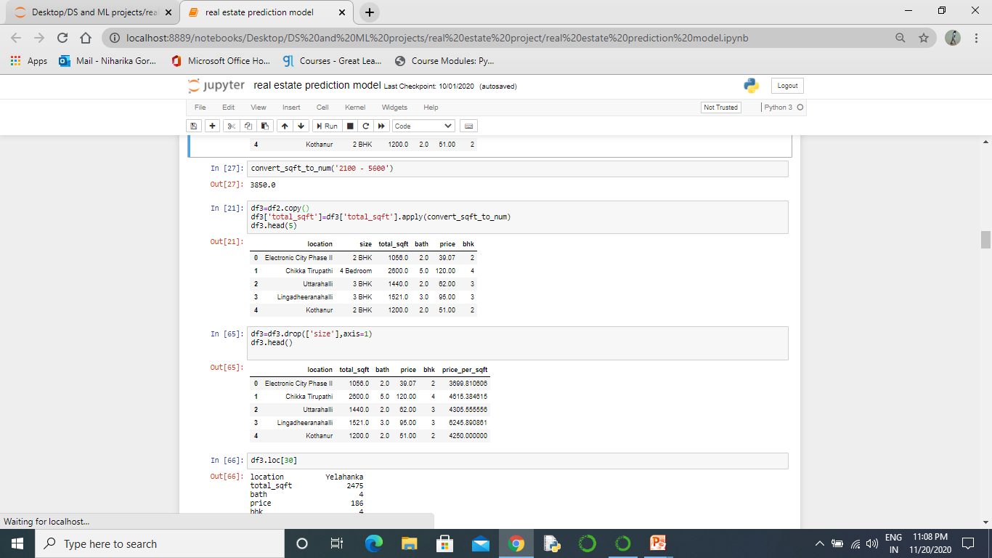
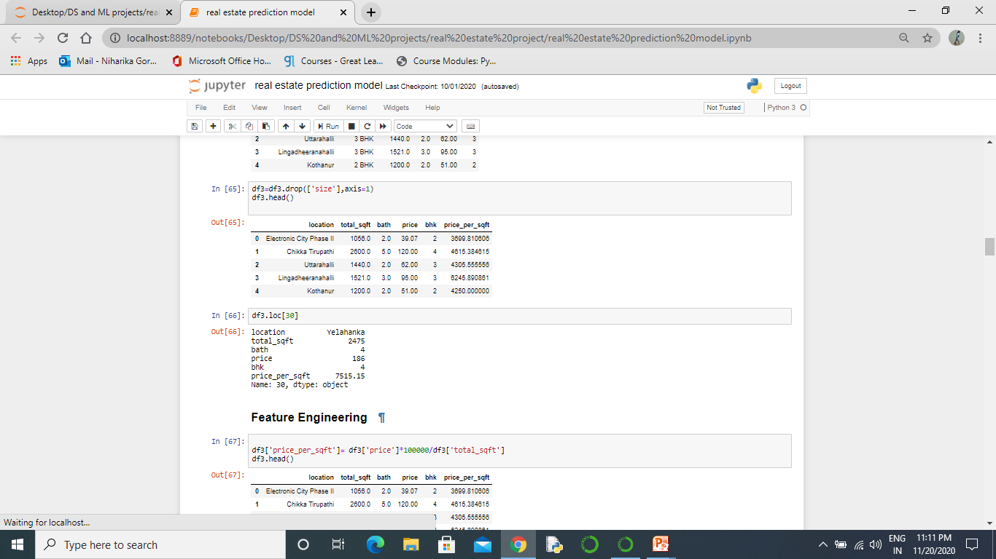
Convert_sqft_to_num(x) function applied on “total_sqft’’ column.
Dropping “size’’ column which is no longer in use.

Slide 16
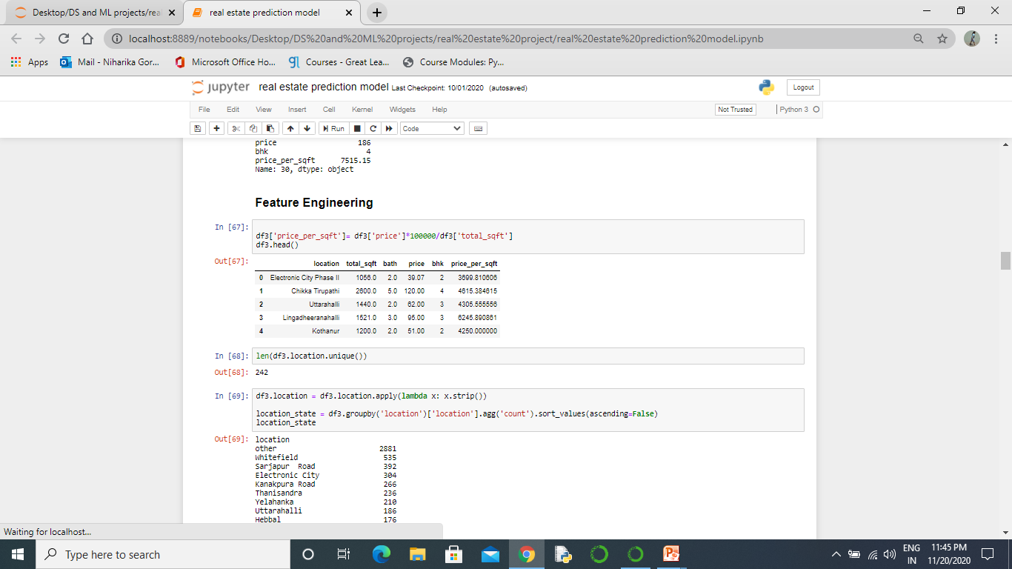
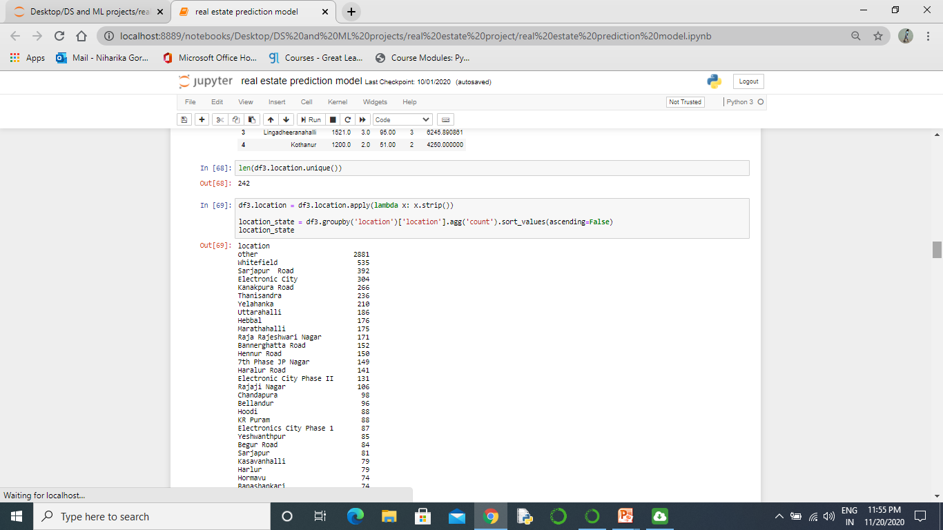
For more information calculating price per square feet.
Unique location in the column

Slide 17
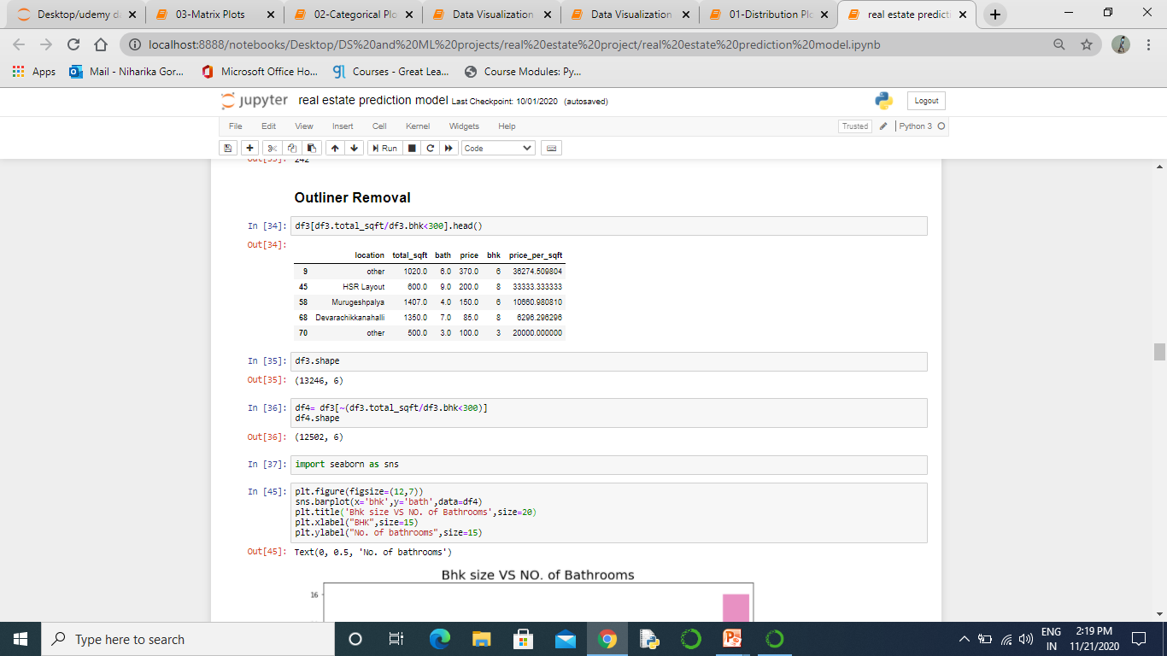
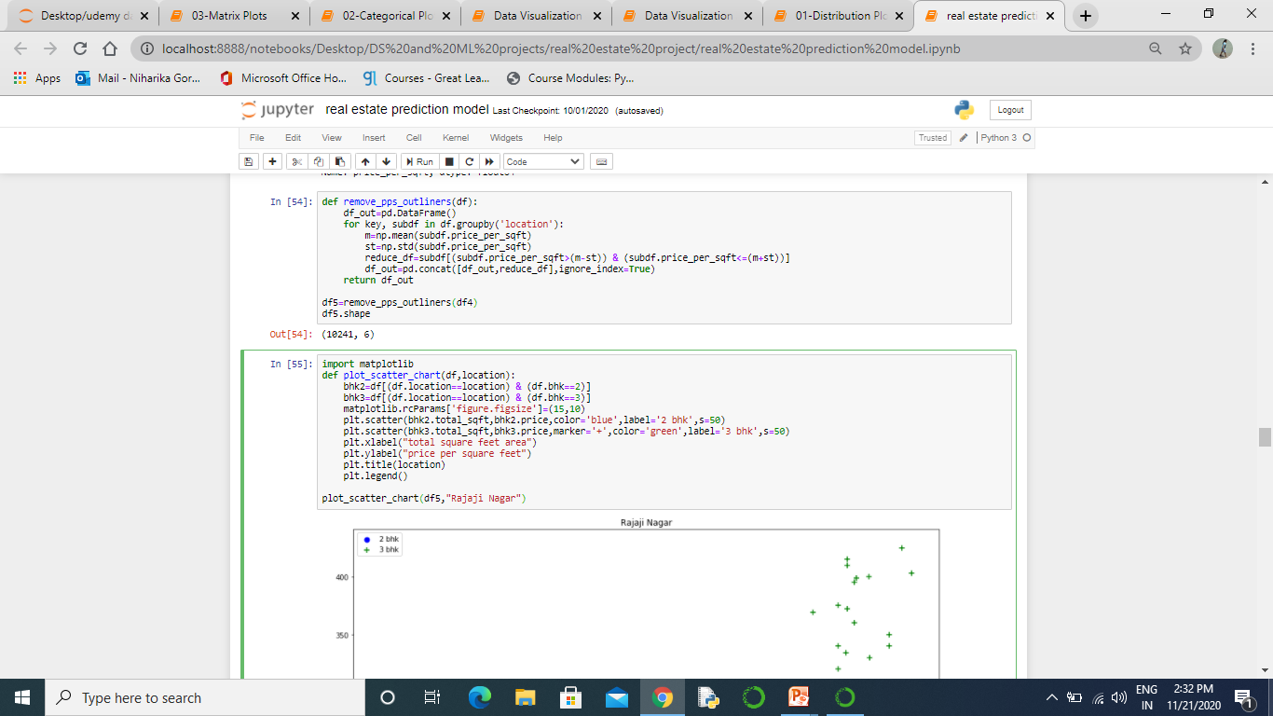
Removing outliners
Removing values whose total_sqft/bhk is <300. For example:- for our first value 1020(total_sqft)/6(bhk)=170. This value will affect our prediction.
Remove_pps_outliners(df) function is removing the values which are not lying between mean+sd and mean-sd of price_per_sqft.

Slide 18
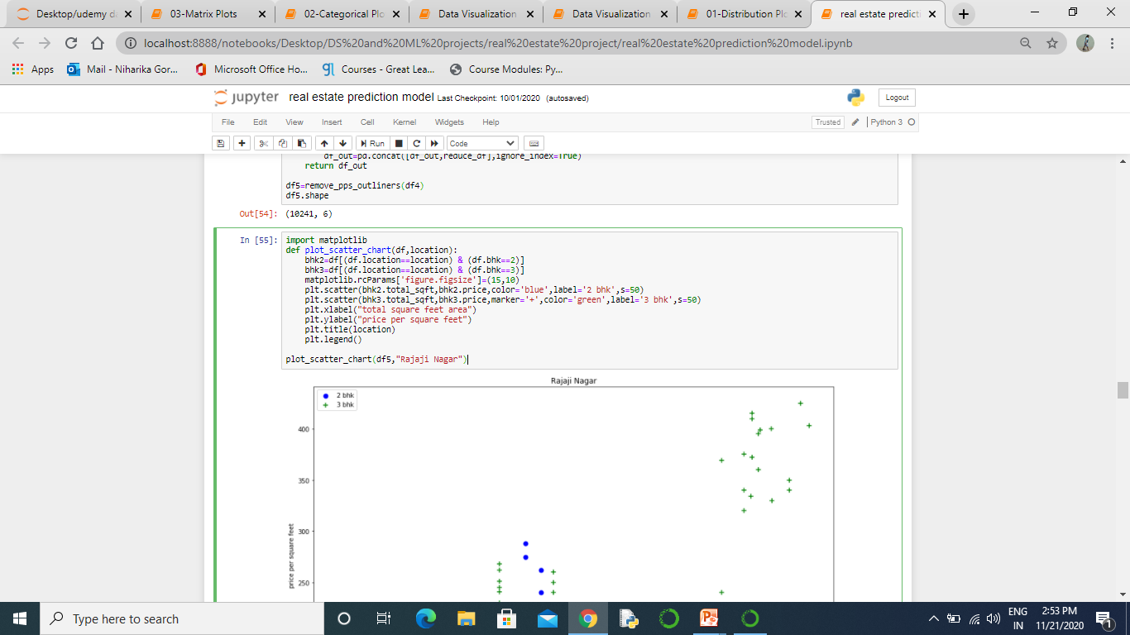
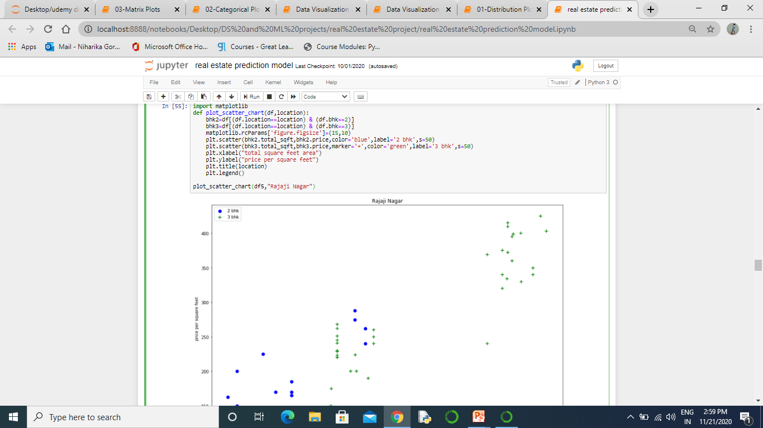
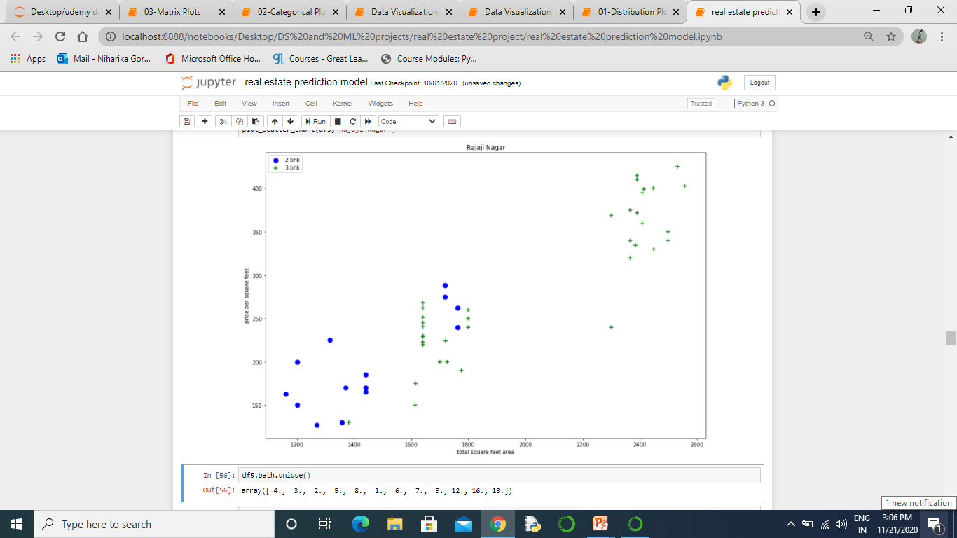
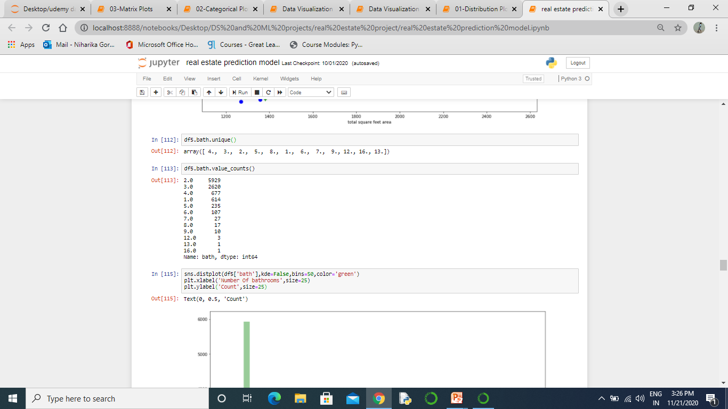
Plot_scatter_chart(df,location) function is plotting a scatter plot for bhk 2 and bhk 3 on the bases of different locations.
Function is executed as

Slide 19
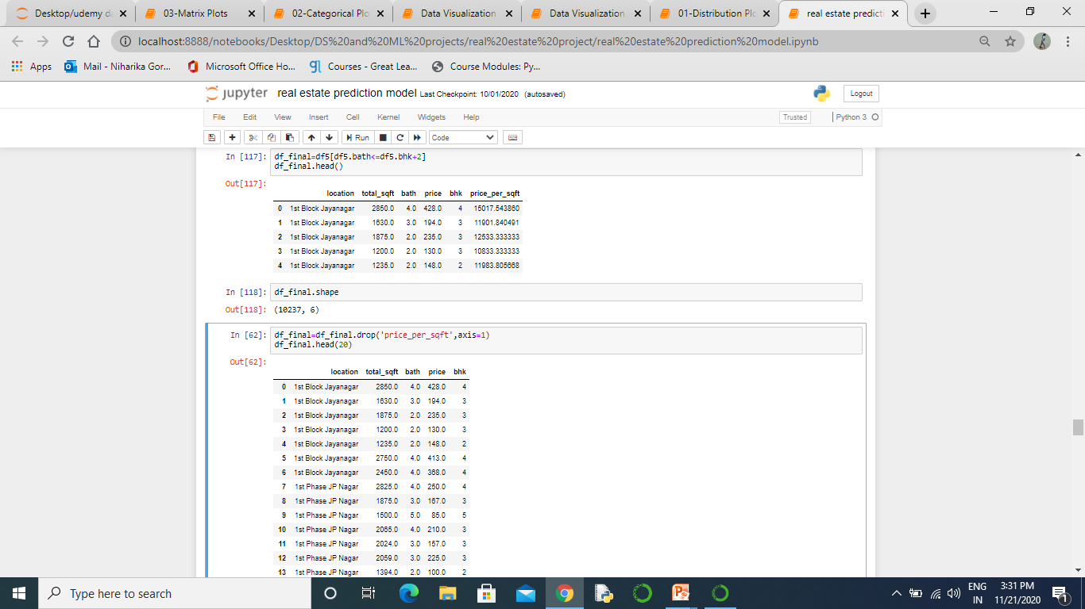
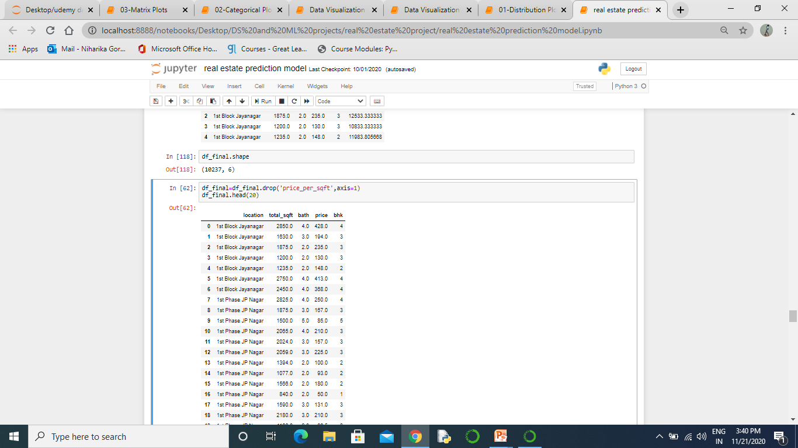
Removing the rows where bath rooms are more than bhk+2
Only 4 values are removed
Dropping column price_per_sqft

Slide 20
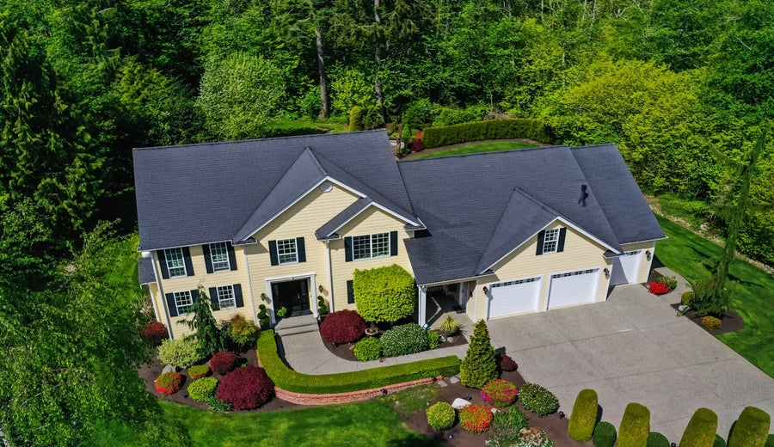
Visualization

Slide 21
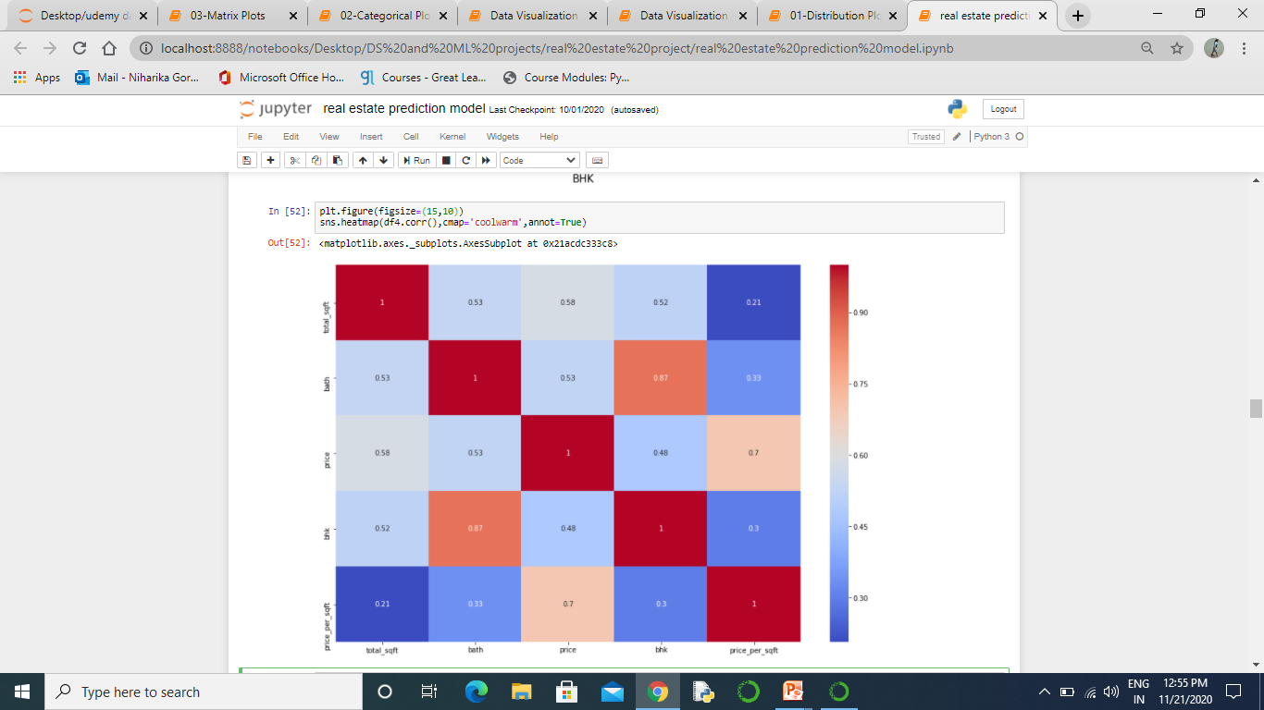
Heatmap Correlation matrix plot

Slide 22
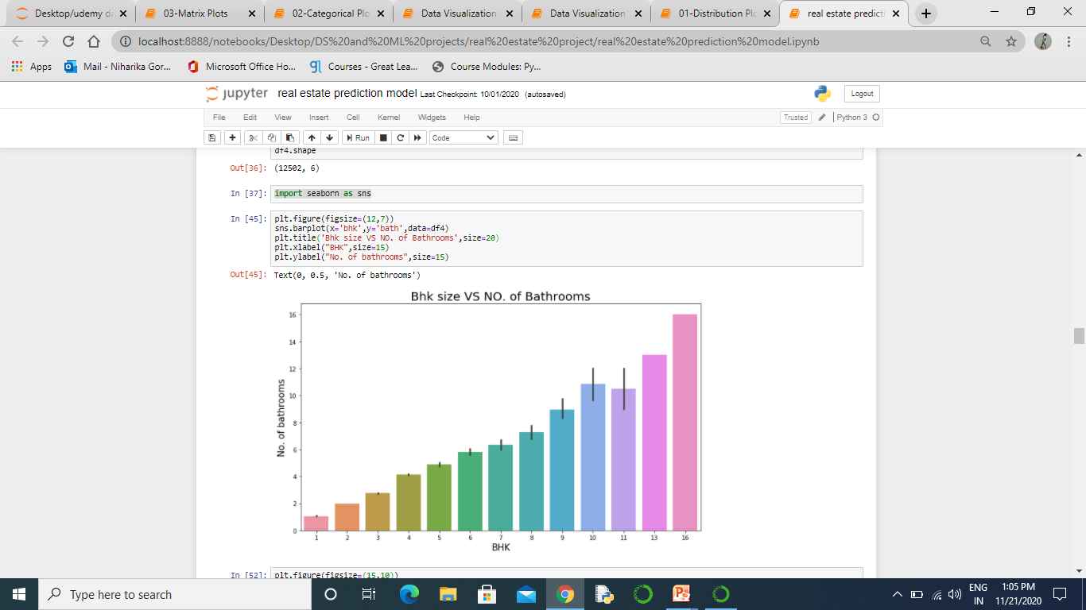
Bar graph for Bhk Vs No. of bathrooms

Slide 23
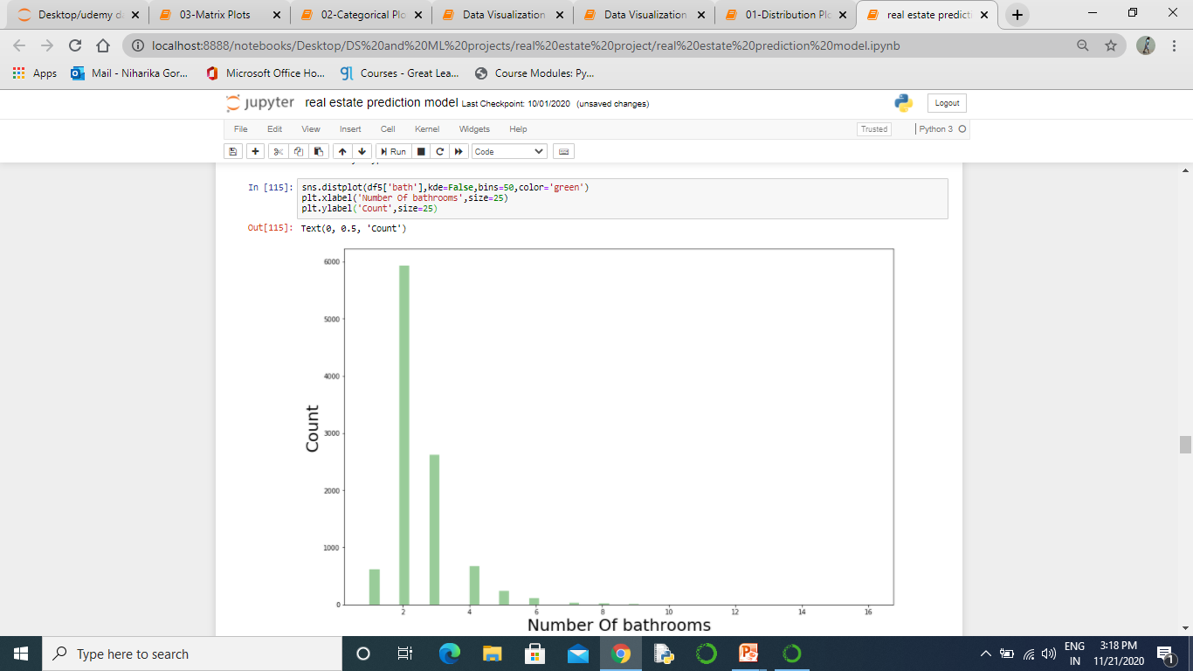
Count plot for no. of bathrooms

Slide 24
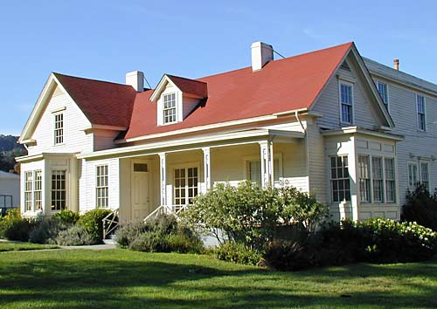
Model Building
Linear Regression, Lasso Regression and Decision Tree Regressor

Slide 25
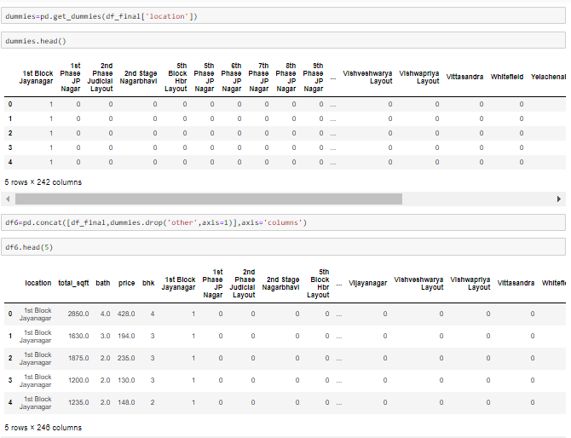
get_dumies is used for the column “location’’.
There are a total of 242 different locations in the dataset. By using get_dumies we had make columns of each location i.e. 242 columns with header as locations.
If a house is available in a that location the value will be 1 other wise it will be 0.

Slide 26
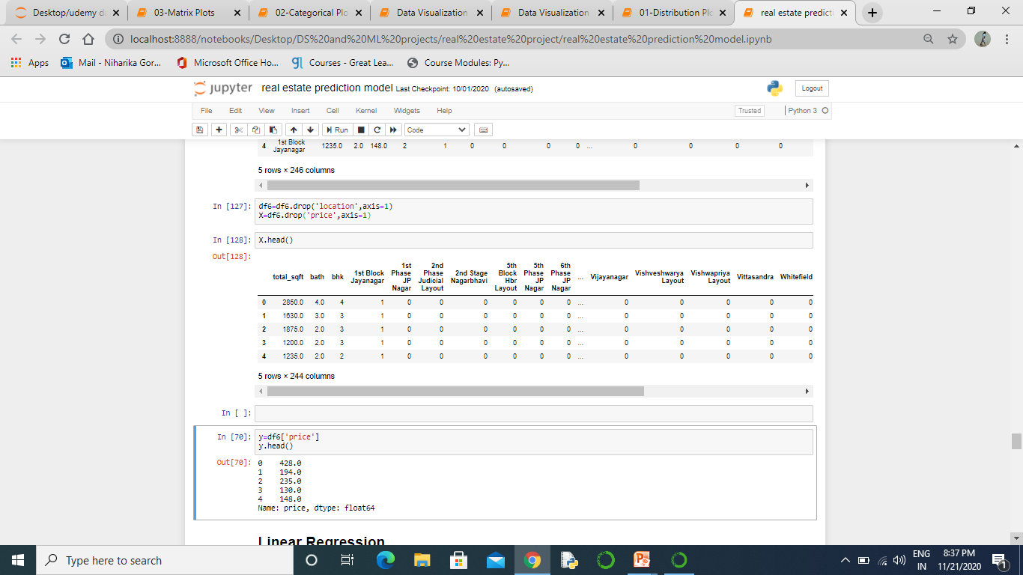
Now we begin to train out regression model! We will need to first split up our data into an X array that contains the features to train on, and a y array with the target variable, in this case the Price column. We will toss out the location column because it only has text info that the linear regression model can't use.

Slide 27
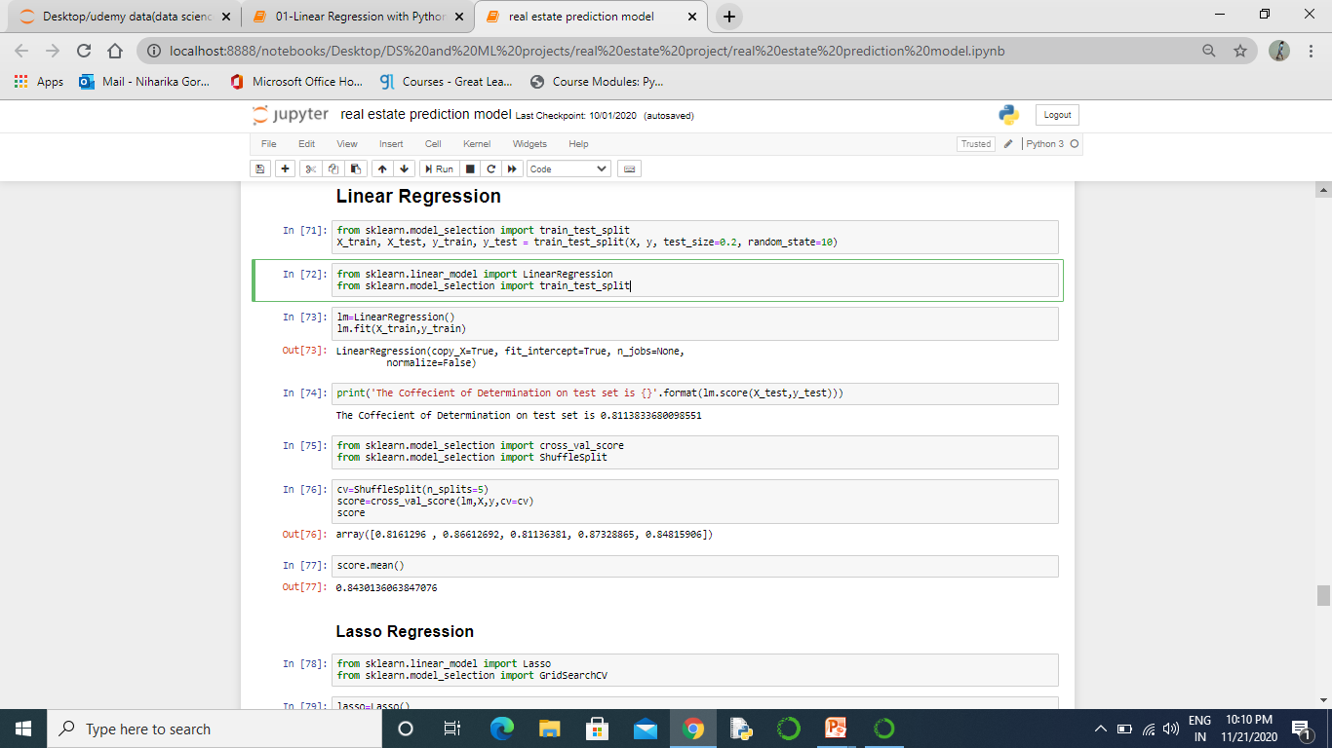
Linear Regression
We split the data into a training set and a testing set. We will train out model on the training set and then use the test set to evaluate the model.
Linear Regression is a supervised machine learning algorithm where the predicted output is continuous and has a constant slope. It's used to predict values within a continuous range, (e.g. sales, price) rather than trying to classify them into categories (e.g. cat, dog).
The coefficient of determination (denoted by R²) is interpreted as the proportion of the variance in the dependent variable that is predictable from the independent variable. An R² of 1 means the dependent variable can be predicted without error from the independent variable.
The goal of K-fold cross-validation is to test the model's ability to predict new data that was not used in estimating it, in order to flag problems like overfitting and to give an insight on how the model will generalize to an independent dataset (i.e., an unknown dataset, for instance from a real problem).

Slide 28
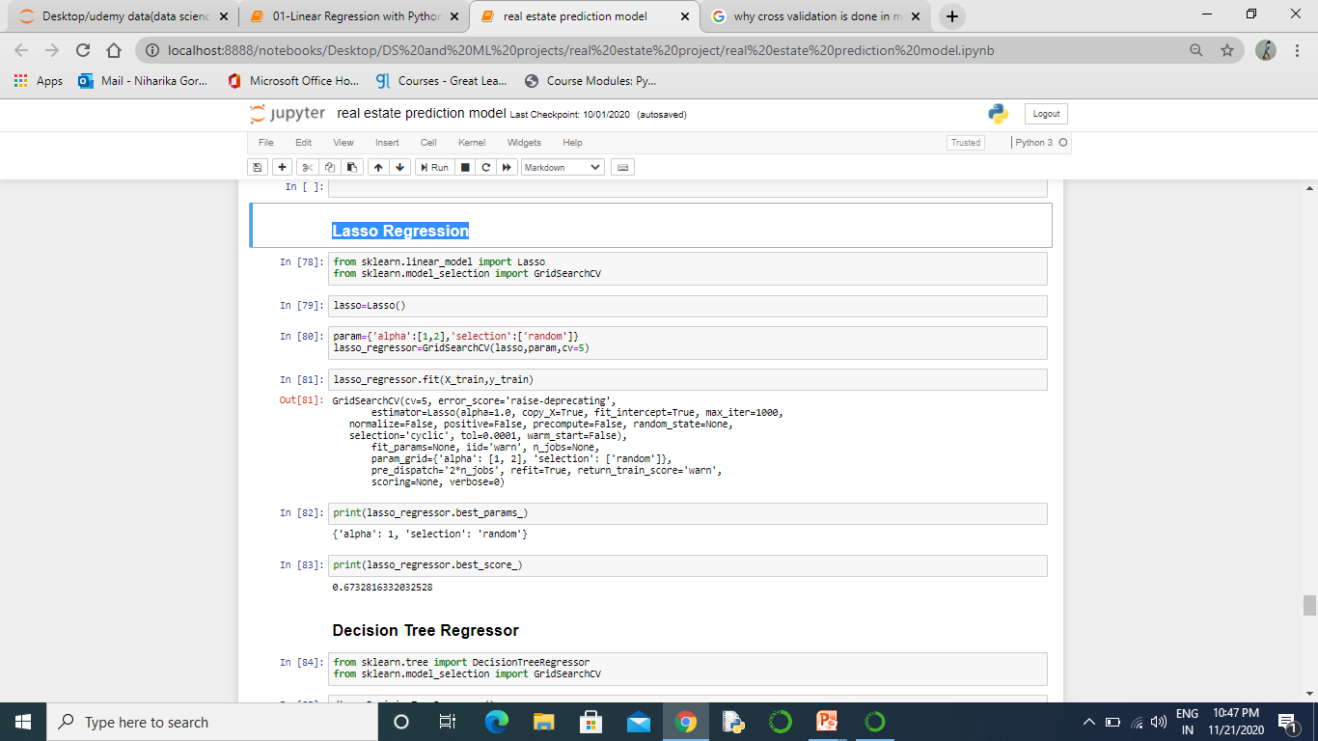
Lasso Regression
lasso (least absolute shrinkage and selection operator; also Lasso or LASSO) is a regression analysis method that performs both variable selection and regularization in order to enhance the prediction accuracy and interpretability of the statistical model it produces.
GridSearchCV is a library function that is a member of sklearn's model_selection package. Grid-search is used to find the optimal hyperparameters of a model which results in the most 'accurate' predictions

Slide 29
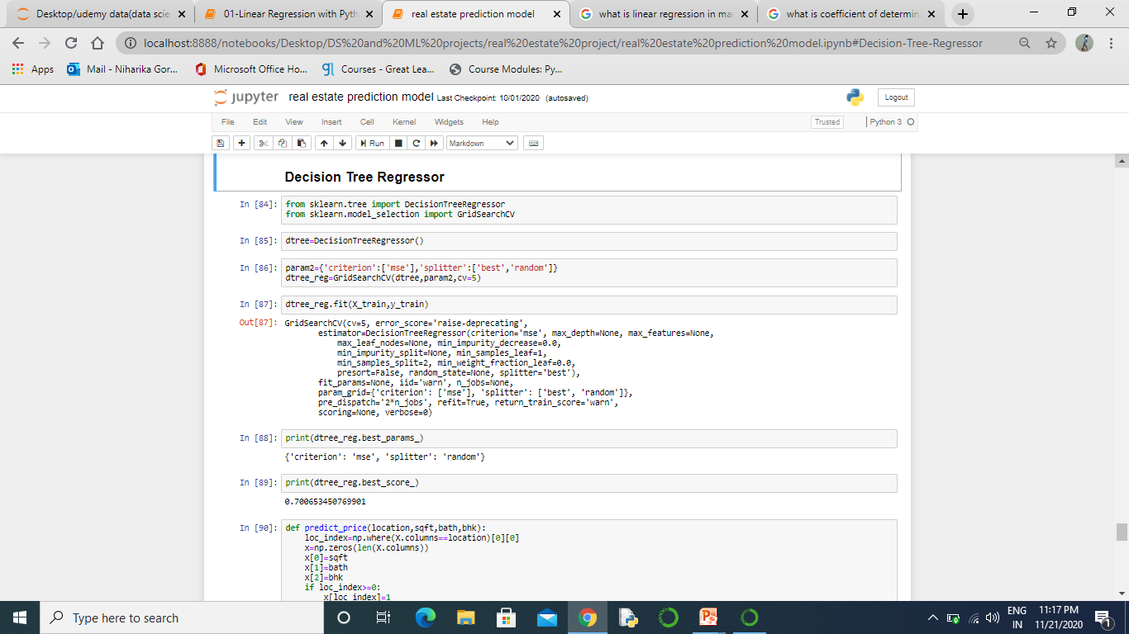
Decision Tree Regressor
Decision tree builds regression or classification models in the form of a tree structure. It breaks down a dataset into smaller and smaller subsets while at the same time an associated decision tree is incrementally developed. The final result is a tree with decision nodes and leaf nodes.

Slide 30
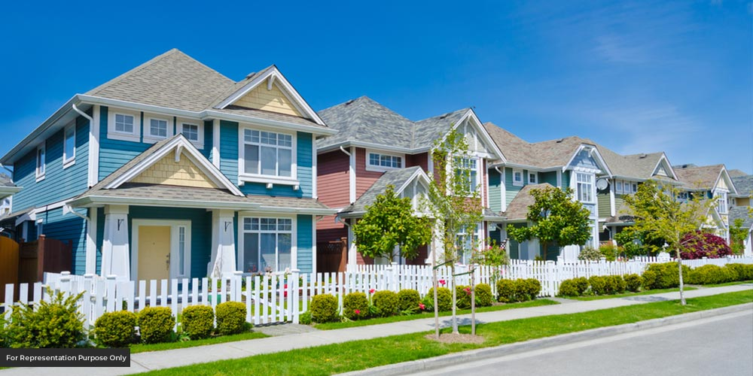
Result and conclusion

Slide 31
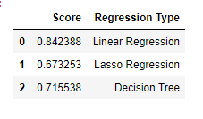
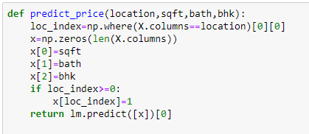
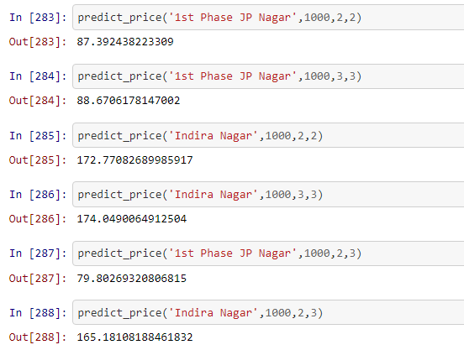
The best scores for the three ML algorithms that we used. It clearly shows that the Linear Regression achieves the highest score and hence will be used in our model for predicting prices.
we have created a price predicting function that finally predicts the price of a property according to the user inputs. The user will input location, square feet, bathrooms and bhk and will get the results. Here you can see we are using ‘lm.predict’ for our model which denotes linear regression as mentioned above.
Here are some of the results from the function that we made for predicting prices.Our model is giving almost 84% accuracy. As you can see from the first and second example, for same location, same sqft area, but one extra bathroom bhk, the price increased. Also from fourth and sixth example, we can see that the price decreased for one less bathroom but the location, sqft area and bhk are same.

Slide 32
Future Works
Add User Interface to the project so that it will become more interactive for the user. The user interface (UI) is the point at which human users interact with a computer, website or application. The goal of effective UI is to make the user's experience easy and intuitive, requiring minimum effort on the user's part to receive maximum desired outcome.

Slide 33
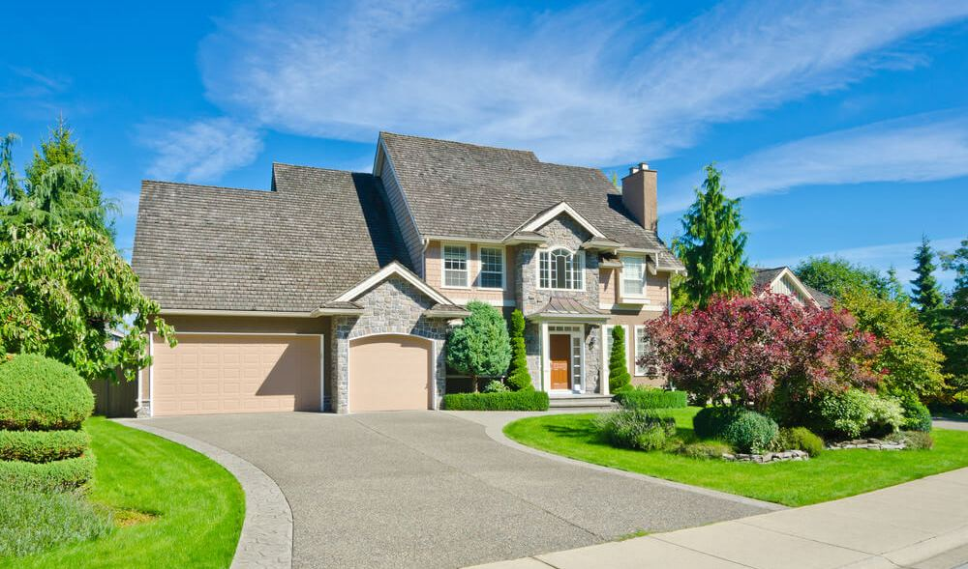
THANK YOU

